Slide 1

Command Line RateYourProfessor
By: Team BEES
[B]ruce Wu
[E]ric Chung
[E]zra Sheng
[S]yed Tihami

Slide 2
Introduction - Project Application
Simulate our version of Rate my Professors
Sorting using similar sort parameters
Name (last)
Average Rating
Average Difficulty
Searching using search parameters
Name (last)
Average Rating
Average Difficulty
Comments
Individual Rating and Difficulty
Comment about the professor/class
Would take again

Slide 3
Team Member Descriptions
Bruce Wu: Team Coordinator/IO/Data Record
Eric Chung: Database, Professor, ProfessorPointer, Rating, Date Classes
Ezra Sheng: Hash Table
Syed Tihami: Binary Search Tree

Slide 4
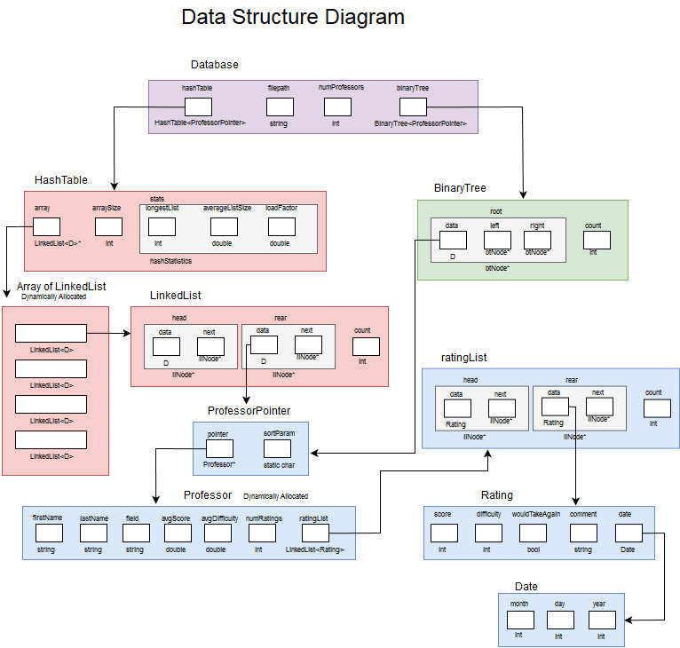
Data Diagram

Slide 5
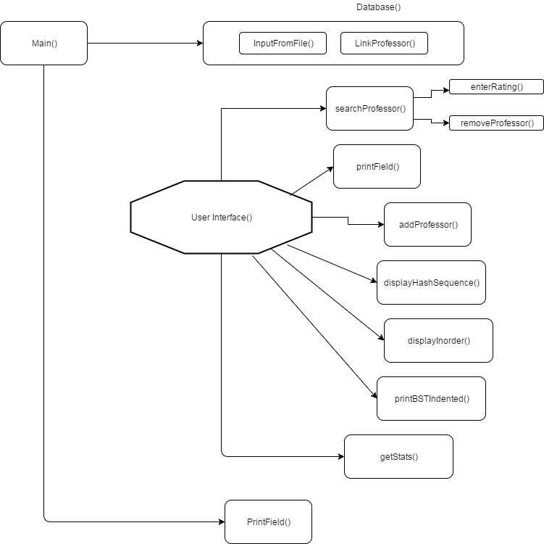
Flow Chart

Slide 6
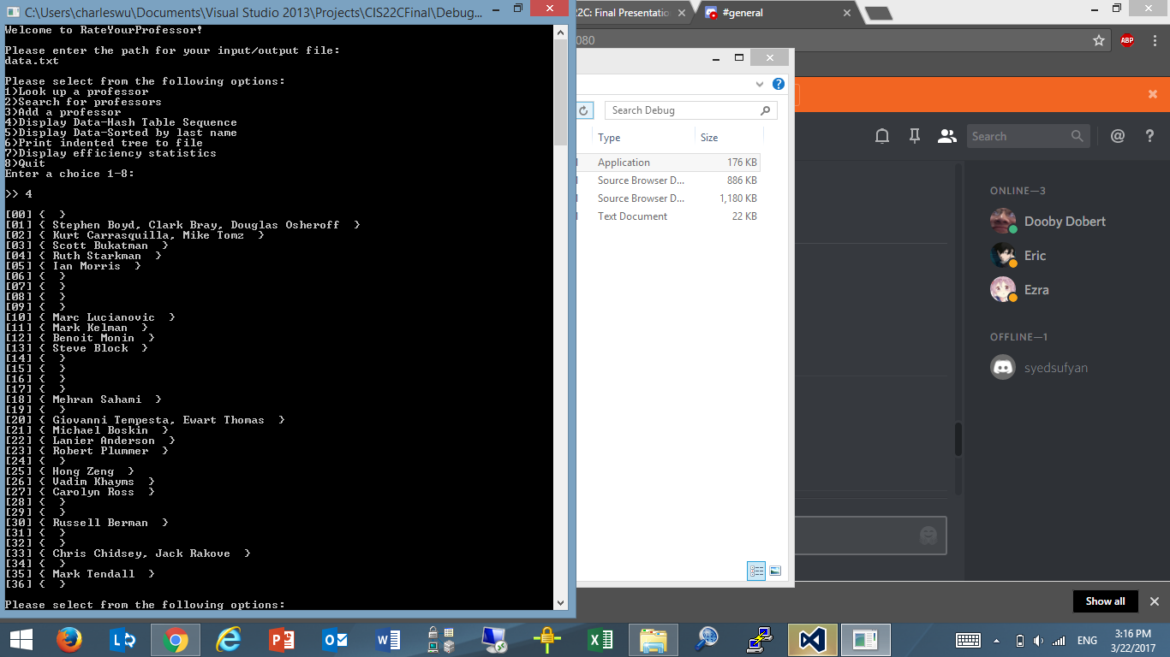
Hash Function
int hash(D entry) {
int value = 0;
for (int i = 0; i < entry.pointer->lastName.length(); i++)
value += entry[i];
return (value * entry.length()) % arraySize;
}
hash(entry)
value = ascii values of each letter in the key(from entry) added up
return (value * length of key) % size of hash table

Slide 7
